Slide 1
SQL SERVER DATE FUNCTIONS
Introduction to SQL Server’s Date Functions

Slide 2
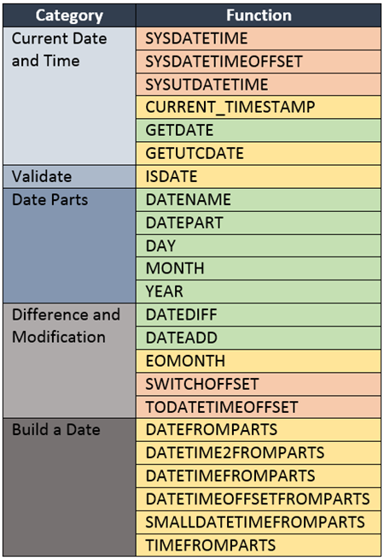
There are over twenty five different functions categorized as date functions in SQL server.
DateTime Functons – Most Common are Colored Green

Slide 3
the most essential of the date functions
1. GETDATE()
Of all of the functions that are used to return the current date and time, the GETDATE function is the most commonly used function.
Functions used to get the Current Date and Time
The GETDATE function is used to return the current data and time of the server. This function becomes handy when you need to compare the data such as the last payment date to the current date.
an example :
SELECT GETDATE()
Which returns
2018-04-27 12:26:53.780

Slide 4
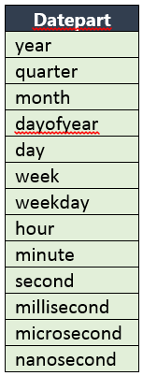
the most essential of the date functions
Functions to get Date Parts
Date parts refer to various components of a date such as the year, month, or day. The date parts are used in several functions in this section and others. Here is a table of date parts that you can use in function such as DATENAME, DATEPART, DATEDIFF, and DATEADD.
Datepart Values

Slide 5
DATENAME()
DATENAME is a very useful function that is used to return various parts of a date such as the name of the month, or day of the week corresponding to a particular date.
The general form of DATENAME is
DATENAME(date part, value)
SELECT DATENAME(year, GETDATE()) as Year,
DATENAME(week, GETDATE()) as Week,
DATENAME(dayofyear, GETDATE()) as DayOfYear,
DATENAME(month, GETDATE()) as Month,
DATENAME(day, GETDATE()) as Day,
DATENAME(weekday, GETDATE()) as WEEKDAY
GETDATE returns 2018-04-27 12:26:53.780
il həftə ilin günləri ay gün həftənin günü
2018 13 87 March 28 Wednesday

Slide 6
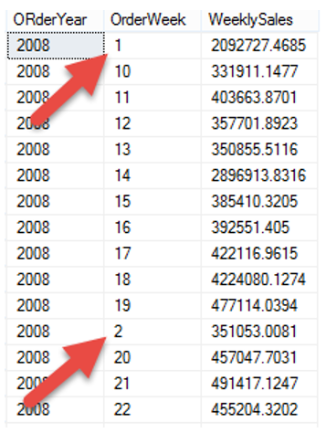
DATENAME (datepart, date)
Here is an example showing how you can use DATANAME to perform some summary level analysis of orders.
Suppose the Sales Manager would like a summary of weekly sales. Using the DATENAME function we can provide that information.
SELECT DATENAME(year, OrderDate) as OrderYear,
DATENAME(week, OrderDate) as OrderWeek,
SUM(TotalDue) as WeeklySales FROM
Sales.SalesOrderHeader WHERE
DATENAME(year, OrderDate) =
'2008' GROUP BY DATENAME(year, OrderDate),
DATENAME(week, OrderDate)
ORDER BY DATENAME(year, OrderDate),
DATENAME(week, OrderDate)

Slide 7
DATEPART (datepart, date)
Returns an integer which represents the specified part of a date. It works very similar to DATENAME, in that you specify a date part and value, however, rather than returning a text value, such as ‘July’, it returns 7.
The general form of DATEPART is
Here is an example which shows various date parts in action. GETDATE
returns 2018-03-27 12:26:53.780
il həftə ilin günləri ay gün həftənin günü
2018 13 87 3 Wednesday
DATEPART(date part, value)
SELECT DATEPART(YEAR, GETDATE()) as Year,
DATEPART(WEEK, GETDATE()) as Week,
DATEPART(DAYOFYEAR, GETDATE()) as DayOfYear,
DATEPART(MONTH, GETDATE()) as Month,
DATEPART(DAY, GETDATE()) as Day,
DATEPART(WEEKDAY, GETDATE()) as WEEKDAY

Slide 8
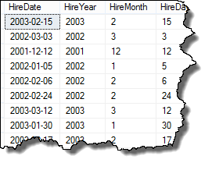
DAY, MONTH, YEAR
The DAY, MONTH, and YEAR functions return, based on a date provided, the day, month, or year as an integer.
DAY(value)
Here is a quick example showing these functions in play;
SELECT HireDate,
YEAR(HireDate) as HireYear,
MONTH(HireDate) HireMonth,
DAY(HireDate) as HireDay
FROM HumanResources.Employee

Slide 9
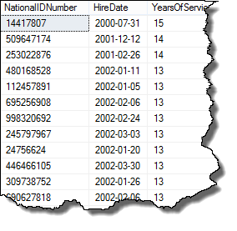
DATEDIFF()
The DATEDIFF function returnes the number years, months, weeks, or days between two dates.
The general form for the DATEDIFF is
To do this we’ll use the DATEDIFF report to both display number of years of service and to also to filter out those with less than ten years of service.
DATEDIFF(date part, start value, end value)
The difference is calculated between start value and end value.
SELECT NationalIDNumber,
HireDate,
DATEDIFF(year, HireDate,
GETDATE()) YearsOfService
FROM HumanResources.Employee
WHERE DATEDIFF(year, HireDate, GETDATE()) >= 10
ORDER BY YearsOfService DESC

Slide 10
DATEADD()
he DATEADD function is used to add years, months, weeks, or days between to a date.
The general form for the DATEADD is
DATEADD(date part,number,value)
If number is positive then that number of date parts are added to the value.
If number is negative, then effective the date parts are subtracted from value.
SELECT DATEADD(DAY, 30, GETDATE())
adds 30 days to the date from the example above: 2018-04-27 15:48:19.490.

Slide 11
ISDATE (expression)
This function tests if the value supplied is a valid date:
In this case, it returns a value of 0 (false) indicating the date is invalid; if it returns a value of 1 (true), the date is valid.
SELECT ISDATE ('07/44/09')

